Slide 1

Employee Attrition
Analysis

Slide 2

Agenda
Introduction
Sample Data
Main KPIs
Dashboard
Key Findings

Slide 3
Employee Attrition
Employee attrition refers to the phenomenon where employees leave a company due to reasons such as retirement, resignation, or termination.
It impacts organizational stability, productivity, and morale, necessitating strategies like retention programs and workplace culture enhancement to mitigate its eff
Employee attrition can be influenced by various factors, including job dissatisfaction, lack of career growth opportunities, inadequate compensation, and poor work-life balance.
Effective leadership and a supportive work environment play key roles in reducing attrition rates.ects.

Slide 4
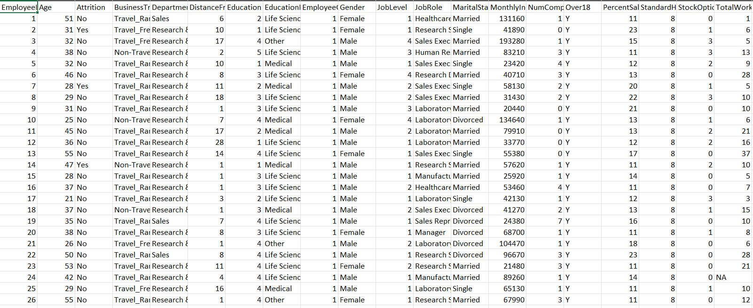
DATA

Slide 5
Main KPIs
No. of Employees
Attrition Rate
Avg Age
Avg Salary
Avg Years at Company
Total Attrition

Slide 6
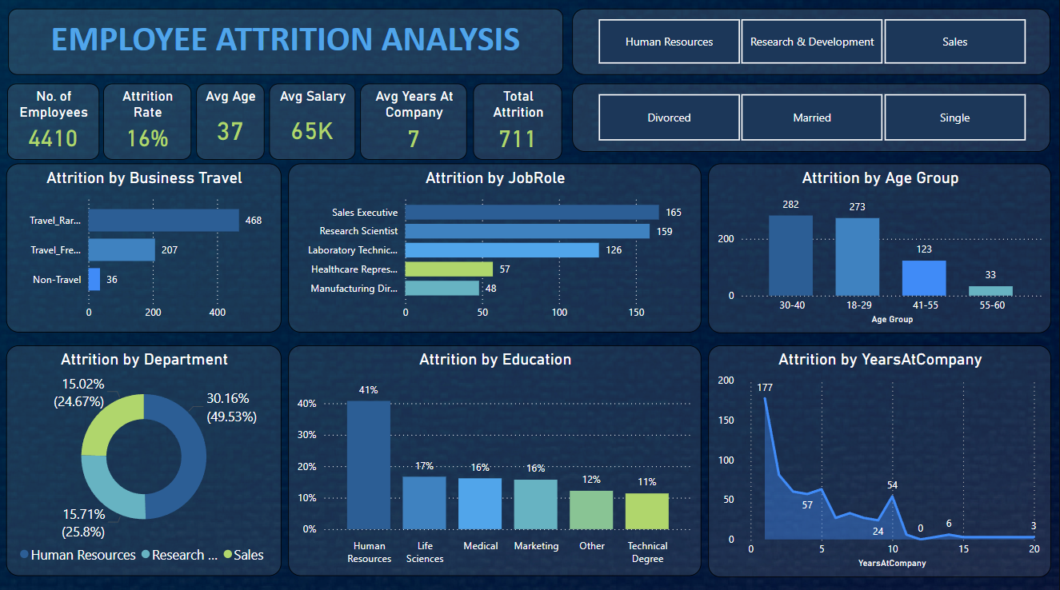
DASHBOARD

Slide 7
Key Findings
The mean age of employees in the organization is estimated to be 37 yrs.
Employees in the organization earn an average monthly income of about 65K.
The average number of years employees have worked at the company is 7.
Attrition is highest in Research and Development and lowest in Human Resources.
The attrition rate is higher for male employees than for female employees.
Married employees top the attrition at 45.8%, while divorced employees have only half of that rate.

Slide 8
Thank you
Vedant Burande
vedd.exe@gmail.com

